Slide 1
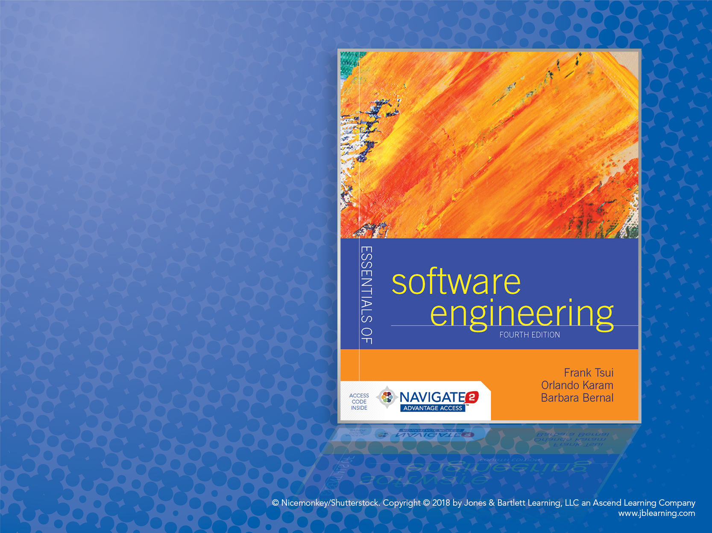
Chapter 9: Implementation

Slide 2
Implementation Topics
Describe:
Characteristics of good implementations
Best practices to achieve them
Understand role of comments.
Learn debugging techniques.
Analyze refactoring.

Slide 3
Introduction
Implementation: transforming detailed design into valid program.
Detailed design may be done as part of implementation.
Faster
Less cohesive and less organized
Writing code, unit testing, debugging, configuration management.

Slide 4
Good Implementations
Readability
Maintainability
Performance
Traceability
Correctness
Completeness
Other issues:
Relative importance?
Tradeoffs?

Slide 5
Coding Guidelines
Organization specific.
Important for consistency.
Programmers can get used to them easily.
Usually mandate:
Indenting, formatting
Naming conventions (for files, variables, etc.)
Language features to use or avoid

Slide 6
Style Issues − I
Be consistent and highlight meaning.
Naming:
Convey meaning.
Be consistent.
Warning: If you can’t think of a good name chances are you don’t understand or the design can be improved.
Multicultural issues.

Slide 7
Style Issues − II
Separating words, capitalization
c_uses_this_style
JavaUsesThisOne
Indentation and spacing
Function/method size
When is it too big? When to break?
File naming
Error-prone constructs

Slide 8
Comments
Types:
Repeat of the code
Explanation of the code
Marker in the code
Summary of the code
Description of the code intent
External references
Keep up to date!

Slide 9
Debugging
Locating and fixing errors in code
Errors noticed by testing, inspection, use
Four phases
Stabilization (reproduction)
Localization
Correction
Verification

Slide 10
Debugging II
Heuristics:
Some routines will have many errors.
Routines with an error tend to have more.
New code tends to have more error.
Particular ones: languages, parts, coders.
Tools
Code comparators
Extended checkers (lint)
Interactive debuggers
Special libraries
Others: profilers, pre/post conditions, test coverage

Slide 11
Assertions
Pre-condition: condition your module requires in order to work
Post-condition: condition that should be true if your module worked
Assertion: executable statement that checks a condition and produces an error if it is not met
Assertions supported by many languages

Slide 12
Performance Optimization
Performance tradeoffs:
Readability?
Maintainability?
Correctness is usually more important.
Profiler: runs a program and calculates how much time it spends on each part.
Cost-benefit analysis.
Measure before “optimizing.”

Slide 13
Refactoring
Improving your code style without affecting its behavior
Bad Smells
Duplicated code
Long method
Large class
Switch statement
Feature envy
Intimacy
Refactorings
Extract method
Substitute algorithm
Move method
Extract class

